Slide 1
Crop Science
Lecture 8
PHOTOSYNTHESIS

Slide 2
Photosynthesis
Life on earth depend on the energy derived from the sun
Photosynthesis is the only process of biological importance that can harvest energy from the sun
Photosynthesis is the use of solar energy to synthesize carbon compounds
6 CO₂ + 6 H₂O → C₆H₁₂O₆ + 6 O₂
Energy stored as carbohydrates can be used to power cellular processes in plants and serve as energy source for all forms of life

Slide 3
Light reaction
The active photosynthetic tissue in higher plants is the mesophyll of leaves
Mesophyll cells contain chloroplasts, the specialized light-absorbing green pigments called chlorophylls
Chloroplast have internal specialized membranes the thylakoids

Slide 4
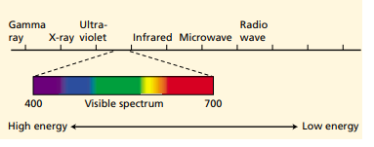
Radiation types
Human eye is sensitive to a narrow range wavelengths of radiation, the visible region, between 400 nm and 700 nm
Short-wavelength light has a high energy content and long wavelength light has a low energy content

Slide 5
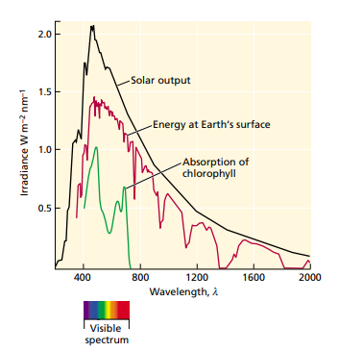
Radiation types

Slide 6
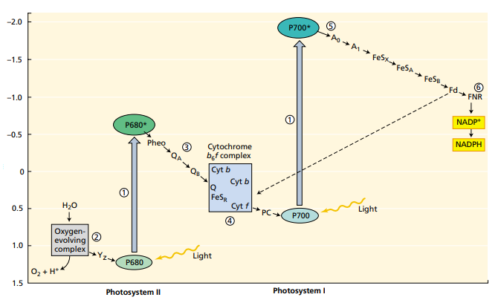
Photosystems

Slide 7
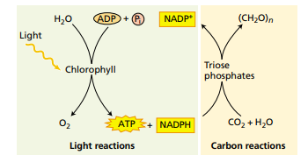
Carbon reactions
Light is required for the generation of ATP and NADPH.
The ATP and NADPH are consumed by the carbon reactions, which reduce CO2 to carbohydrate

Slide 8
THE CALVIN CYCLE
Plants reduce CO2 to carbohydrate via the photosynthetic carbon reduction cycle called the Calvin cycle
Carbon dioxide and water from the environment are enzymatically combined to form a large chain of carbon molecules
Basic process for Carbon three plant (C3)

Slide 9
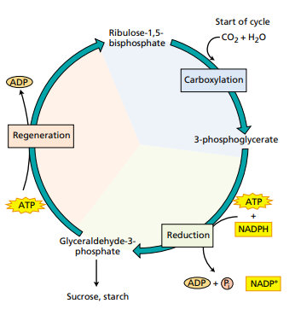
Calvin cycle

Slide 10
Calvin cycle application
C4 plants efficiently recycle the carbon back to the cycle
Usually associated with hot environments
Crassulacean plants close stomata during the day and open at night
Associated with desert environment

Slide 11
Physiological and economical considerations
Environmental factors that guide photosynthesis
Light
carbon dioxide concentration
temperature
Leaf structure in response to light or shade environments
Thin leaf layer in shade
Shorter palisade cells in shade

Slide 12
Leaf orientation
Solar tracking is the leaf orientation toward sun rays
Exposure to sunlight for a long time increases heat and leaf respond by reflecting heat back through
Sensible heat loss – air circulation around the leaf removes heat from surface
Evaporative heat loss – evaporation on the leaf reduce heat energy on leaf

Slide 13
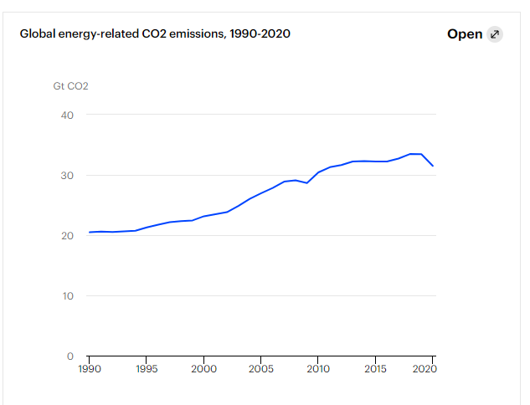
Carbon dioxide emission

Slide 14
Carbon emission
Burning of fossil fuels contributes to increase in carbon dioxide in the atmosphere
Carbon dioxide saturation point of C3 plants is high than in C4 plants

